Slide 1

Accreditation Program

Slide 2
History of the Consortium
2010: Convened as Informal Consortium by 4 FQHC-based postgraduate NP training programs
2013: Identified Accreditation as a goal
2013 – 2015: CHCI formally incorporated a new 501c3, the Consortium, to advance the postgrad NP training movement, including development of the Accreditation Program
2016: Accreditation Action for the first 2 Programs
2022: Consortium receives Federal Recognition as Accrediting Agency from the US Department of Education
2022: Consortium starts accrediting Joint NP and PA Programs
2023: 22 Accredited Programs and 11 Programs in the Pipeline

Slide 3
Accreditation Defined
External, independent review of a health care training program against nationally-accepted Standards and its own policies, procedures, processes, and outcome (AAAHC)
Peer-reviewed, voluntary program evaluation
Practice-based determination of adherence to National Standards
National acknowledgement of quality

Slide 4
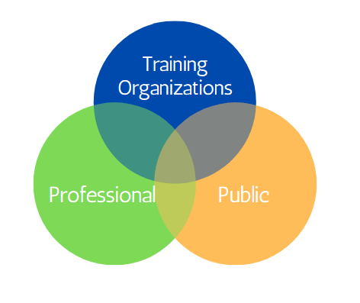
Benefits of Accreditation

Slide 5
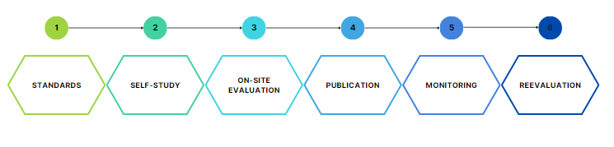
USDE Accreditation Process
6 Major Steps

Slide 6
Consortium’s Standards Driving
Excellence in Program Design
Standard 1: Mission, Goals, Objectives
Standard 2: Curriculum
Standard 3: Evaluation
Standard 4: Program Eligibility
Standard 5: Administration
Standard 6: Operations
Standard 7: Staff
Standard 8: Postgraduate Trainee Services

Slide 7
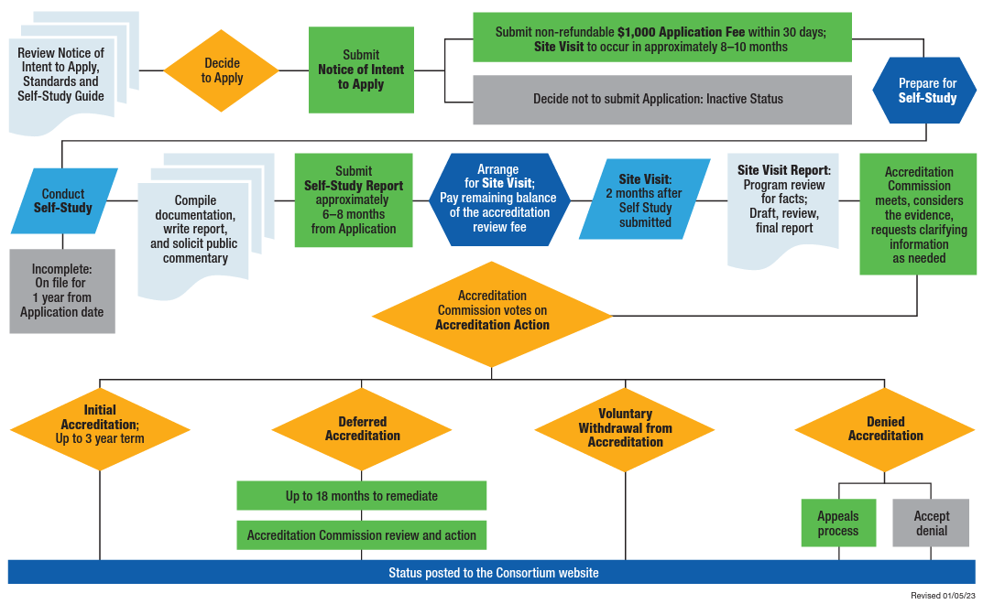
Accreditation Process

Slide 8
Consortium Accreditation Sample Timeline
General Timeframe, Application to Decision (10-12 months)
Intent to Apply
Application
Self Study: internal program evaluation
1.5 day On-site Visit: external program evaluation (completed by 2 trained site visitor peers (educator, administrator, clinician)
Site Visit Report: reviewed by program, submitted to Accreditation Commission for accreditation consideration
Decision: Accredited, Deferral, or Denial of Accreditation
Posted to Consortium website
Annual and Interim Reports
Extensive technical support available throughout the process

Slide 9

Accreditation Anchors Program Development

Slide 10
Contact Info:
Kerry Bamrick, MBA
  Executive Director
  Kerry.Bamrick@APPpostgradtraining.com
www.APPpostgradtraining.com

